Slide 1
Data and Computer Communications
Internet Applications
Multimedia
MIS420
Carlo Mobarak
Sagesse University
2018

Slide 2
What is Multimedia?
Derived from the word “Multi” and “Media”
  Multi
    Many, Multiple,
  Media
    Tools that is used to represent or do a certain things, delivery medium, a form of mass communication – newspaper, magazine / tv.
    Distribution tool & information presentation – text, graphic, voice, images, music and etc.

Slide 3

Definition of Multimedia
Multimedia is a combination of text, graphic, sound, animation, and video that is delivered interactively to the user by electronic or digitally manipulated means.
GRAPHIC
TEXT
MULTIMEDIA
VIDEO
AUDIO
ANIMATION

Slide 4
Elements of Multimedia
TEXT
GRAPHIC
TEXT
MULTIMEDIA
AUDIO
VIDEO
ANIMATION
A broad term for something that contains words to express something.
Text is the most basic element of multimedia.
A good choice of words could help convey the intended message to the users (keywords).
Used in contents, menus, navigational buttons

Slide 5
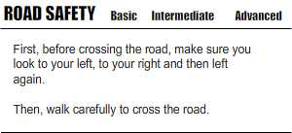
Elements of Multimedia
TEXT
GRAPHIC
TEXT
MULTIMEDIA
AUDIO
VIDEO
ANIMATION
Example

Slide 6
Elements of Multimedia
TEXT
GRAPHIC
GRAPHIC
MULTIMEDIA
AUDIO
VIDEO
ANIMATION
Two-dimensional figure or illustration
Could be produced manually (by drawing, painting, carving, etc.) or by computer graphics technology.
Used in multimedia to show more clearly what a particular information is all about (diagrams, picture).

Slide 7
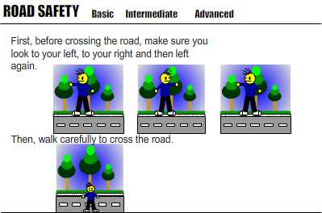
Elements of Multimedia
TEXT
GRAPHIC
GRAPHIC
MULTIMEDIA
AUDIO
VIDEO
ANIMATION
Example

Slide 8
Elements of Multimedia
TEXT
GRAPHIC
AUDIO
MULTIMEDIA
AUDIO
VIDEO
ANIMATION
Produced by vibration, as perceived by the sense of hearing.
In multimedia, audio could come in the form of speech, sound effects and also music score.

Slide 9
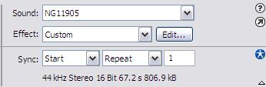
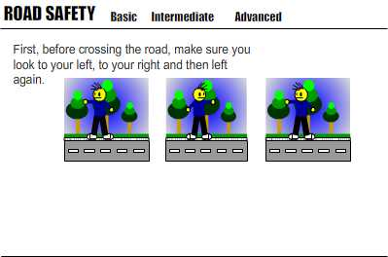
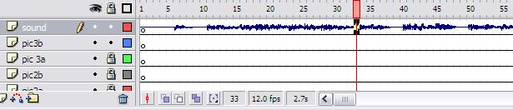
Elements of Multimedia
TEXT
GRAPHIC
AUDIO
MULTIMEDIA
AUDIO
VIDEO
ANIMATION
Example

Slide 10
Elements of Multimedia
TEXT
GRAPHIC
ANIMATION
MULTIMEDIA
AUDIO
VIDEO
ANIMATION
The illusion of motion created by the consecutive display of images of static elements.
In multimedia, animation is used to further enhance / enriched the experience of the user to further understand the information conveyed to them.

Slide 11
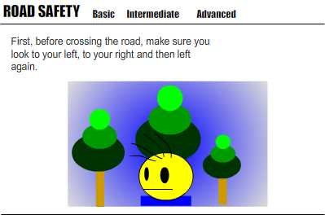
Elements of Multimedia
TEXT
GRAPHIC
ANIMATION
MULTIMEDIA
AUDIO
VIDEO
ANIMATION
Example

Slide 12
Elements of Multimedia
TEXT
GRAPHIC
VIDEO
MULTIMEDIA
AUDIO
VIDEO
ANIMATION
Is the technology of capturing, recording, processing, transmitting, and reconstructing moving pictures.
Video is more towards photo realistic image sequence / live recording as in comparison to animation.
Video also takes a lot of storage space. So plan carefully before you are going to use it.

Slide 13
Interactive Multimedia
When the user is given the option of controlling the elements.
Hyper Media
A combination of hypertext, graphics, audio, video, (linked elements) and interactivity culminating in a complete, non-linear computer-based experience.

Slide 14
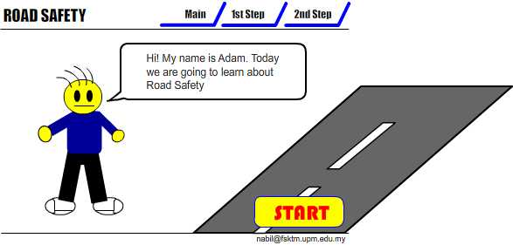
Example
Interactive Multimedia

Slide 15
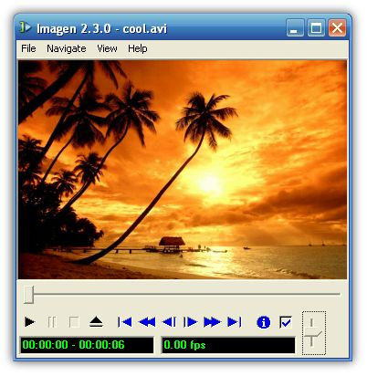


Example
Hyper Media
Main Page
Video link
Image link
Audio Link

Slide 16
Linear VS Non-Linear
LINEAR
A Multimedia Project is identified as Linear when:
  It is not interactive
  User have no control over the content that is being showed to them.
Example:
  A movie
  A non-interactive lecture / demo show

Slide 17
Linear VS Non-Linear
NON-LINEAR
A Multimedia Project is identified as Non-Linear when:
  It is interactive
  Users have control over the content that is being showed to them.
  Users are given navigational control
Example:
  Games
  Courseware
  Interactive CD

Slide 18
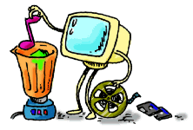
Authoring Tools
Use to merge multimedia elements (text, audio, graphic, animation, video) into a project.
Designed to manage individual multimedia elements and provide user interaction (if required).

Slide 19
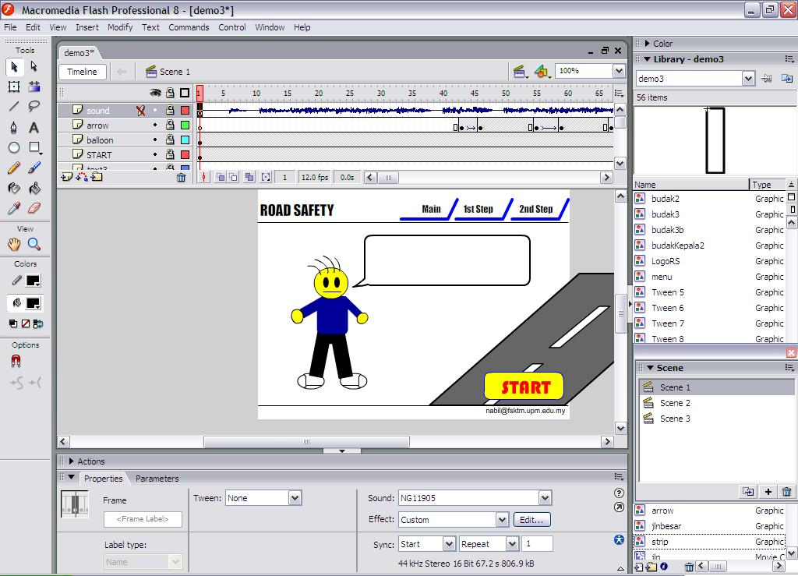
Authoring Tools
Example:
  Macromedia Authorware
  Macromedia Director
  Macromedia Flash
  Microsoft Power Point

Slide 20
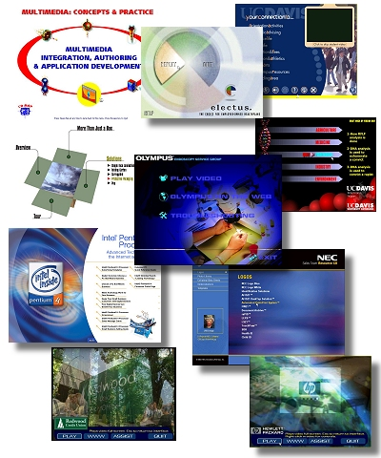
Importance of Multimedia
There are a number of fields where multimedia could be of use. Examples are:-
  Business
  Education
  Entertainment
  Home
  Public Places

Slide 21
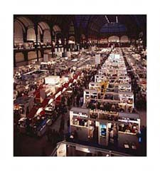
Importance of Multimedia
Business
  Use and Applications
    Sales / Marketing Presentation
    Trade show production
    Staff Training Application
    Company Kiosk

Slide 22

Importance of Multimedia
Education
  Use and Applications
    Courseware / Simulations
    E-Learning / Distance Learning
    Information Searching

Slide 23

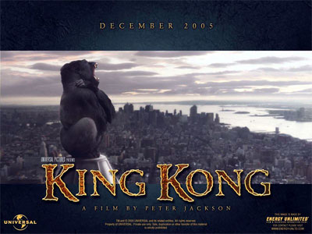
Importance of Multimedia
Entertainment
  Use and Applications
    Games (Leisure / Educational)
    Movies
    Video on Demand
      Online

Slide 24



Importance of Multimedia
Home
  Use and Applications
    Television
    Satellite TV
    SMS services (chats, voting, reality TV)

Slide 25
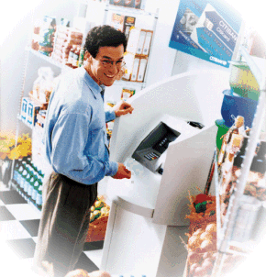
Importance of Multimedia
Public Places
  Use and Applications
    Information Kiosk
    Smart Cards, Security

Slide 26
Multimedia Products
Briefing Products
Reference Products
Database Products
Education and Training Products
Kiosk
Entertainment and Games

Slide 27
Multimedia Products
Briefing Products
1
Small, straightforward, linear products used to present information quickly and concisely.
Characteristic of briefing product:
  Short Development Cycle
  Limited Number of Presentations
  Usage of text to present information with limited use of graphic, audio and video.
  Have few navigational controls. (mouse click and button press to move from one page to another)
  Content and the format are suitable for the audience and fulfill the purpose of the presentation.

Slide 28
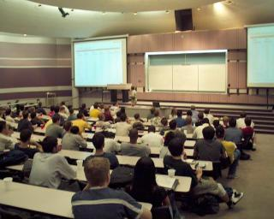
Multimedia Products
Briefing Products
1
Good briefing presentation depends on:
  The understanding of the presented subject.
  Seamless integration of content.
  Consistent layout
Example:
  Corporate Presentation
  Sales Presentation
  Educational Lectures

Slide 29
Multimedia Products
Reference Products
2
Often used for answering specific questions or for general browsing of information. (stored on CD/ DVD ROM)
Characteristic of reference product:
  Used by wide range of user (small – adult)
  Have navigational menu, book marking, searching, printing utility
2 Basic classes of reference product:
  Generalized Content (dictionary/encyclopedia)
    Broad treatment of content at a limited depth
  Detailed Content
    Focus on specific area and provide extensive information.

Slide 30
Multimedia Products
Reference Products
2
Good usability and success depends on:
  The developers understanding the body of information and how the end user will want to access it.
  Help function should always available to explain how to access and use the information
Examples are electronic forms of:
  Encyclopedia
  Dictionaries
  Cookbooks, Historical, Informative
  Scientific surveys.

Slide 31
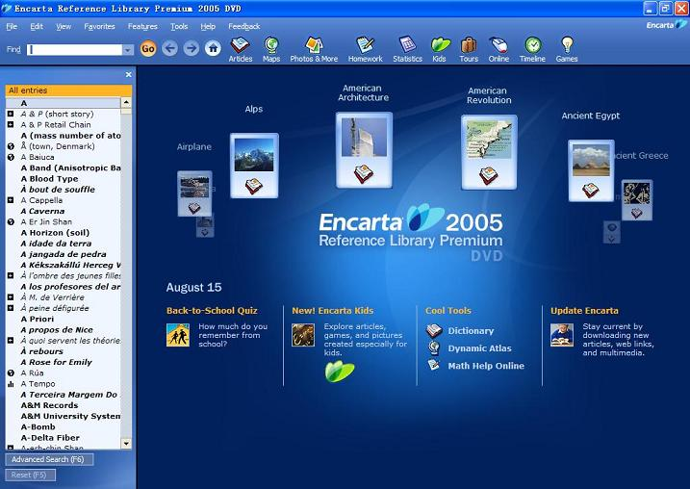
Multimedia Products
Reference Products
2
Example:

Slide 32
Multimedia Products
Database Products
3
Similar to reference product in a sense that large amount of information are made available to the end user.
Focus on storing and accessing the actual data (multimedia data such as text, graphic, audio, animation and video)
Characteristics of Database Products are:
  Manages multimedia data (large data)
  Descriptive finding methods
    Content based search
  Simultaneous access
    Online database
  Relational consistency in data management.

Slide 33
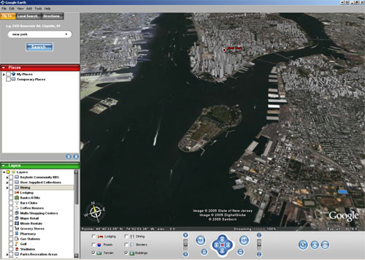
Multimedia Products
Database Products
3
Examples are:
  Google Search
  Google Earth

Slide 34
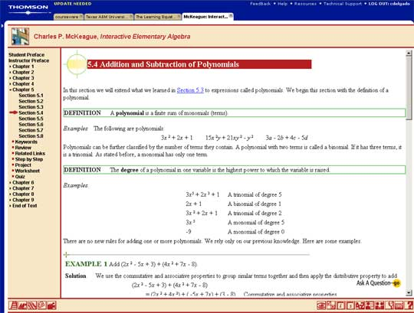
Multimedia Products
Education and Training Products
4
Similar to textbook or training manuals but have added media such as audio, animation and video.
Make up a significant share of the multimedia market ranging from pre-kindergarten to postgraduate offerings from technical to corporate training products.
2 categories of reference product:
  Instructor Support Products
  Standalone or Self-Paced Products
  Combination Products
Shares the same characteristics as Reference Product

Slide 35
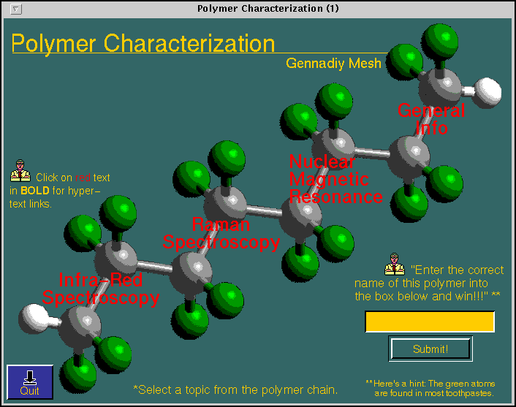
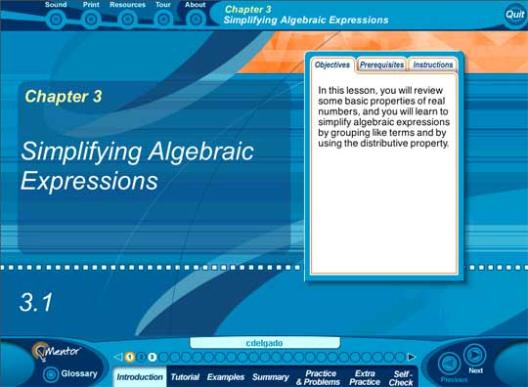
Multimedia Products
Education and Training Products
4
Example

Slide 36
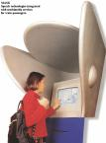
Multimedia Products
Kiosk Products
5
A product which is usually stationed at public places and allow the user to find information interactively and also other types of transaction.
Characteristics of Kiosk Products:-
  Limited target users and usage.
  User friendly and easily used by user.
  Fast response.

Slide 37

Multimedia Products
Kiosk Products
5
Categories of Kiosk
  Point Of Information
    Provide certain information (example map, timetable etc)
  Point Of Sales System
    Allow users to purchase or make orders
Example of Kiosk Products:-
  Instant Photo Booth
  Banking Kiosk (money deposit, cheque)
  University Information Kiosk

Slide 38
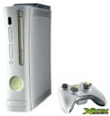

Multimedia Products
Entertainment & Games
6
Most popular
Shipped in the form of Interactive CD / DVD ROM.
Characteristics of E & G Products:-
  Immersive.
  Requires constant feedback and interaction with the user.
  Challenging and sometimes intriguing for user
  Enabled online play for more than one user experience.

Slide 39
Audio and Video Compression
multimedia applications need efficient use of transmission capacity
hence audio/video compression algorithms
techniques standardized by MPEG
lossless compression loses no information
  limited by redundancy in original data
lossy compression provides acceptable approximation to original (typically use)
Notes:
For multimedia applications, it is important to make the most efficient use of transmission capacity as possible. Accordingly, much attention has been paid to the development of compression algorithms for both audio and video transmissions. The techniques discussed in this section were standardized by the Moving Picture Experts Group (MPEG). MPEG, under the auspices of the International Organization for Standardization (ISO), has developed standards for video and associated audio in digital form. The MPEG effort covers not only video compression, but also audio compression and associated system issues and formats. The premise of the MPEG effort is that a video signal can be compressed to a bit rate of about 1.5 Mbps with acceptable quality and that corresponding efficiencies are achievable for audio transmission.
First we introduce two terms. Data compression falls into two broad categories: lossless and lossy. With lossless compression, no information is lost and the decompressed data are identical to the original uncompressed data. The efficiency of lossless compression is limited to the process of eliminating some or all of the redundancy in a bit stream, so that no information is lost. With lossy compression, the decompressed data may be an acceptable approximation (according to some fidelity criterion) to the original uncompressed data. We will see that lossy compression is used for both audio and video. However, in the case of audio, the fidelity of the output is so high that, for all practical purposes, the compression is lossless.

Slide 40
Video Compression
moving picture a sequence of still images
hence can compress each individually
but get greater efficiency by using similarities between adjacent images
encode just differences between them
approach used in MPEG
Notes:
A moving picture is simply a succession of still pictures. Accordingly, one can achieve a degree of compression by independently compressing each still picture in the sequence that makes up the moving picture. But much more can be done. Even in a moving picture with a lot of action, the differences between adjacent still pictures are generally small compared to the amount of information in a single still picture. This suggests that an encoding of the differences between adjacent still pictures is a fruitful approach to compression; this is a tool used in MPEG.

Slide 41
MPEG Video Compression
important features in video compression
  random access - needs access frames
  fast forward / reverse - scan stream using access frames
MPEG foundation is motion compensation
  prediction
  interpolation
Notes:
In designing the video compression algorithm, the MPEG study group identified a number of features that are important in order to meet the range of applications of MPEG. Two of these are relevant to our discussion:
• Random access: A compressed video bit stream should be accessible at any point in the sequence of video frames, and any frame should be decodable in a limited amount of time. This implies the existence of access frames, which are frames coded only in intraframe mode and that therefore can be decoded without reference to other frames.
• Fast forward/reverse searches: It should be possible to scan a compressed bit stream and, using the appropriate access frames, display selected frames to obtain a fast forward or fast reverse effect. This feature is essentially a more demanding form of the random access feature.
The foundation of MPEG interframe compression is motion compensation. The idea behind motion compensation is that a portion of an image in one frame will be the same as or very similar to an equal-sized portion in a nearby frame. The MPEG scheme makes use of two forms of motion compensation: prediction and interpolation.

Slide 42
Real-Time Traffic
increasing deployment of high-speed nets sees increasing real-time traffic use
has different requirements to traditional non real-time traffic
  traditionally throughput, delay, reliability
  real-time more concerned with timing issues
  with deadline for delivery of data block
Notes:
The widespread deployment of high-speed LANs and WANs and the increase in the line capacity on the Internet and other internets has opened up the possibility of using IP-based networks for the transport of real-time traffic. However, it is important to recognize that the requirements of real-time traffic differ from those of high-speed but non-real-time traffic. With traditional internet applications, such as file transfer, electronic mail, and client/server applications including the Web, the performance metrics of interest are generally throughput and delay. There is also a concern with reliability, and mechanisms are used to make sure that no data are lost, corrupted, or misordered during transit. By contrast, real-time applications are more concerned with timing issues. In most cases, there is a requirement that data be delivered at a constant rate equal to the sending rate. In other cases, a deadline is associated with each block of data, such that the data are not usable after the deadline has expired.

Slide 43
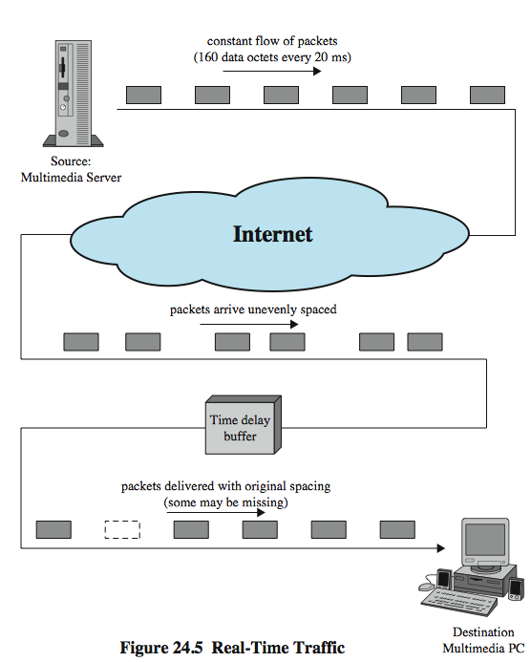
Real-Time Traffic
Example
Notes:
Stallings DCC8e Figure 24.5 illustrates a typical real-time environment. Here, a server is generating audio to be transmitted at 64 kbps. The digitized audio is transmitted in packets containing 160 octets of data, so that one packet is issued every 20 ms. These packets are passed through an internet and delivered to a multimedia PC, which plays the audio in real time as it arrives. However, because of the variable delay imposed by the Internet, the interarrival times between packets are not maintained at a fixed 20 ms at the destination. To compensate for this, the incoming packets are buffered, delayed slightly, and then released at a constant rate to the software that generates the audio.
The compensation provided by the delay buffer is limited. To understand this, we need to define the concept of delay jitter, which is the maximum variation in delay experienced by packets in a single session. For example, if the minimum end-to-end delay seen by any packet is 1 ms and the maximum is 6 ms, then the delay jitter is 5 ms. As long as the time delay buffer delays incoming packets by at least 5 ms, then the output of the buffer will include all incoming packets. However, if the buffer delayed packets only by 4 ms, then any incoming packets that had experienced a relative delay of more than 4 ms (an absolute delay of more than 5 ms) would have to be discarded so as not to be played back out of order.

Slide 44
Real-Time Traffic Requirements
low jitter
low latency
integrate non-real-time and real-time services
adapts to changing network / traffic conditions
good performance for large nets / connections
modest buffer requirements within the network
high effective capacity utilization
low overhead in header bits per packet
low processing overhead
Notes:
[ARAS94] lists the following as desirable properties for real-time communication:
• Low jitter
• Low latency
• Ability to easily integrate non-real-time and real-time services
• Adaptable to dynamically changing network and traffic conditions
• Good performance for large networks and large numbers of connections
• Modest buffer requirements within the network
• High effective capacity utilization
• Low overhead in header bits per packet
• Low processing overhead per packet within the network and at the end system
These requirements are difficult to meet in a wide area IP-based network or internet. Neither TCP nor UDP by itself is appropriate. We will see that RTP provides a reasonable foundation for addressing these issues.

Slide 45
Hard vs Soft Real-Time Apps
soft real-time applications
  tolerate loss of some data
  hence impose fewer requirements on network
  can focus on maximizing network utilization
hard real-time applications
  zero loss tolerance
  hence deterministic upper bound on jitter and high reliability take precedence over utilization
Notes:
A distinction needs to be made between hard and soft real-time communication applications. Soft real-time applications can tolerate the loss of some portion of the communicated data, while hard real-time applications have zero loss tolerance. In general, soft real-time applications impose fewer requirements on the network, and it is therefore permissible to focus on maximizing network utilization, even at the cost of some lost or misordered packets. In hard real-time applications, a deterministic upper bound on jitter and high reliability take precedence over network utilization considerations.

